Slide 1
Feasibility of Multi-Cut-Off Rebar
for Construction Application
Advisor : Prof. K.C.Chang
Presenters : You-Ran Nai
Notes:
Try 講清楚脈絡

Slide 2
Outline
Part 2
Part 4
Flexural Reinforcement Multi-Cut
Seismic Verification
Part 1
Part 3
Objective
Condition

Slide 3
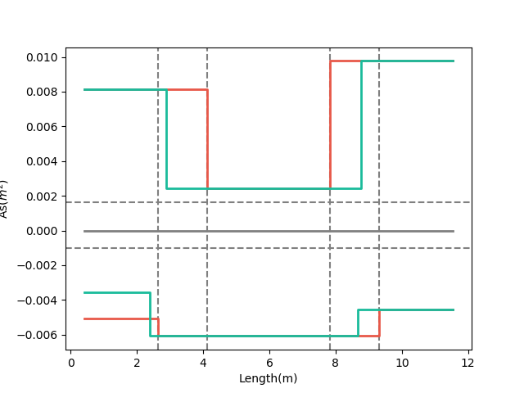
- Tradition
- Multi-Cut-2
梁用鋼量圖
12-#10
10-#10
REDUCE REBAR
3-#10
上層筋
下層筋
7-#8
9-#8
12-#8
Real
Demand
Notes:
LowSeismic4Floor12M 0

Slide 4
- Tradition
- Multi-Cut-2
梁用鋼量圖
12-#10
10-#10
REDUCE REBAR
3-#10
上層筋
下層筋
7-#8
9-#8
12-#8
Real
Demand
Notes:
LowSeismic4Floor12M 0

Slide 5
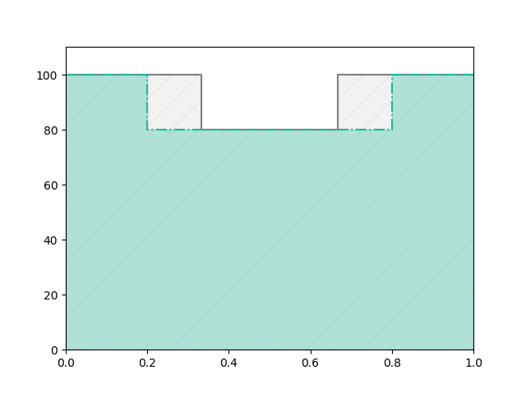
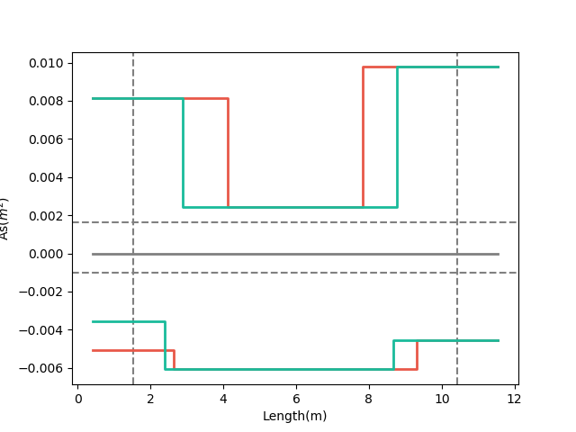
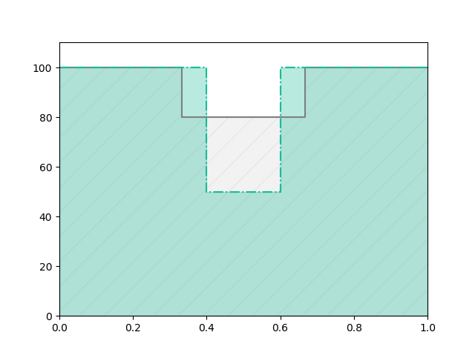
梁用鋼量圖
Before
換圖說明
As(cm2)
After
REDUCE REBAR
Beam Length(m)
Before
Real
Demand
After

Slide 6
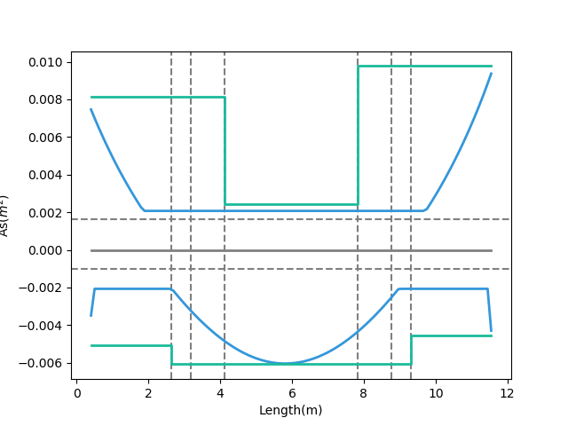
需要更好懂
- Design As
- Demand As
Today’s Solution
Fixed Bar-Cut
Notes:
LowSeismic4Floor12M 0

Slide 7
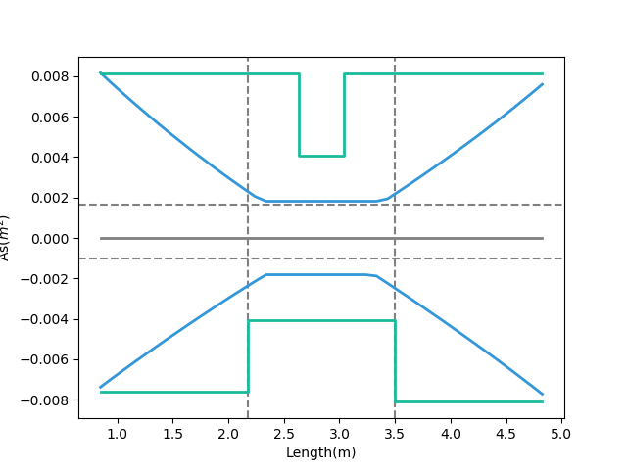
Tradition
- Design As
- Demand As
Notes:
欣銓 1140

Slide 8
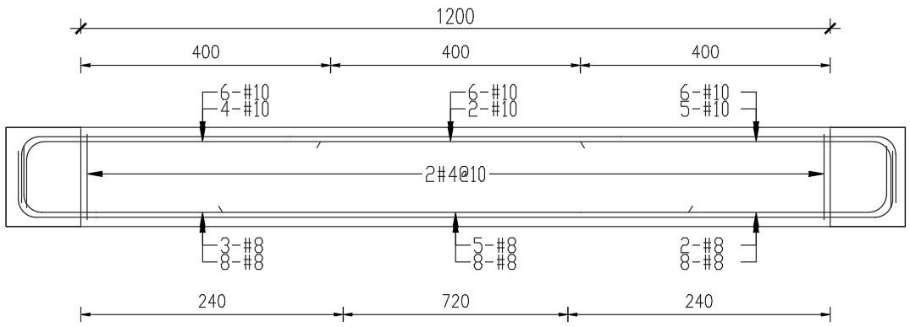
- Demand As
- Design As
梁撓曲鋼筋配置示意圖
Notes:
LowSeismic4Floor12M 0

Slide 9
Outline
Part 2
Part 4
Flexural Reinforcement Multi-Cut
Seismic Verification
Part 1
Part 3
Objective
Condition

Slide 10
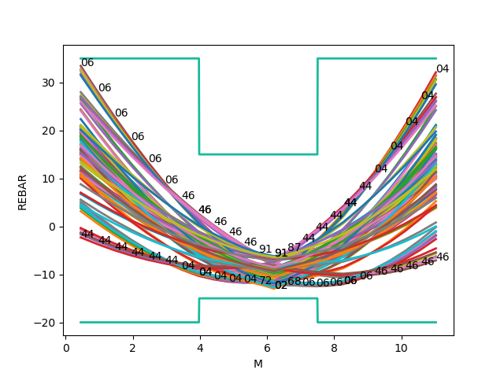
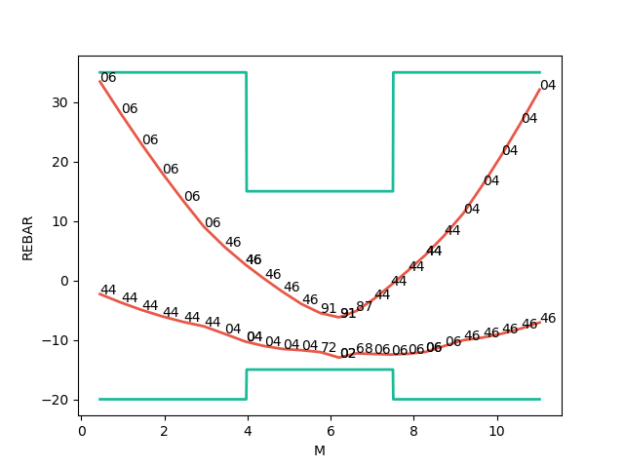
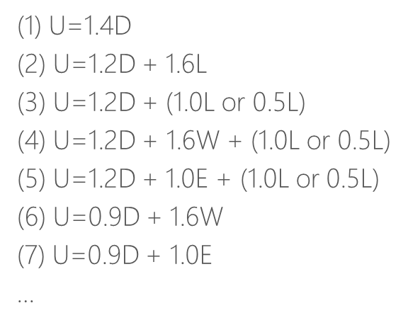
Mu
Consider Hundreds Of Combo Demand
Catch Critical Demand Combo

Slide 11
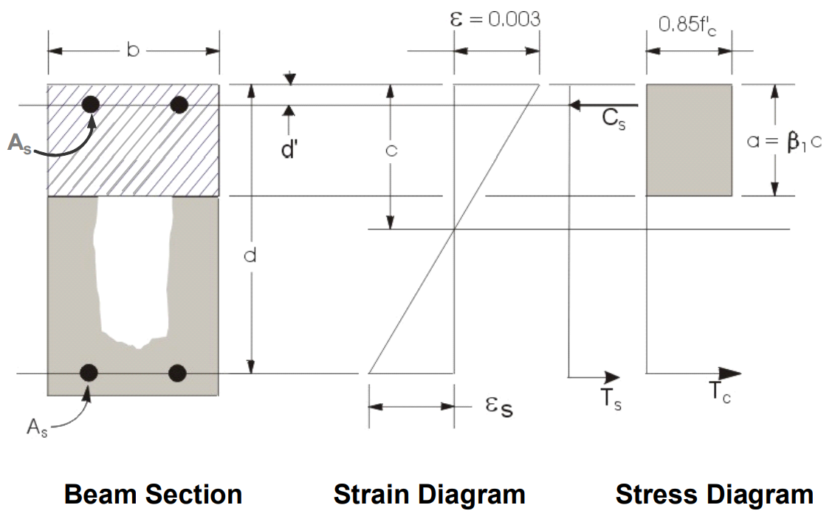
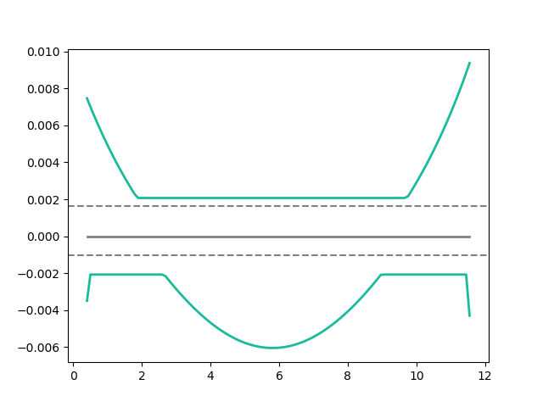
Flexural Reinforcement
- Demand As
Min: 2 Rebar
Notes:
LowSeismic 4Floor 12M 0

Slide 12
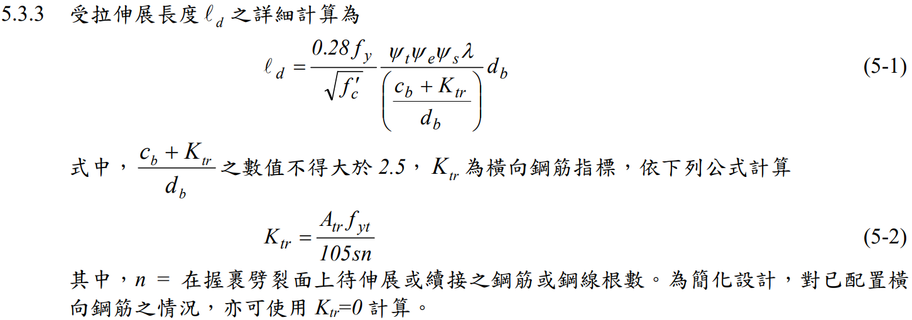
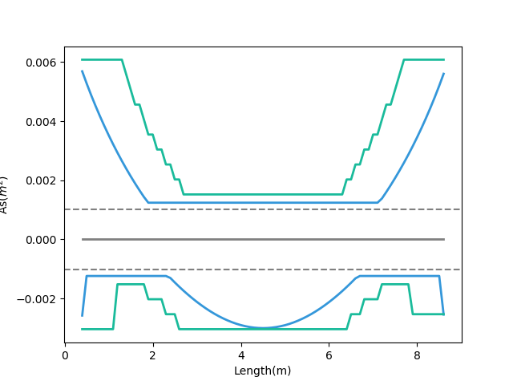
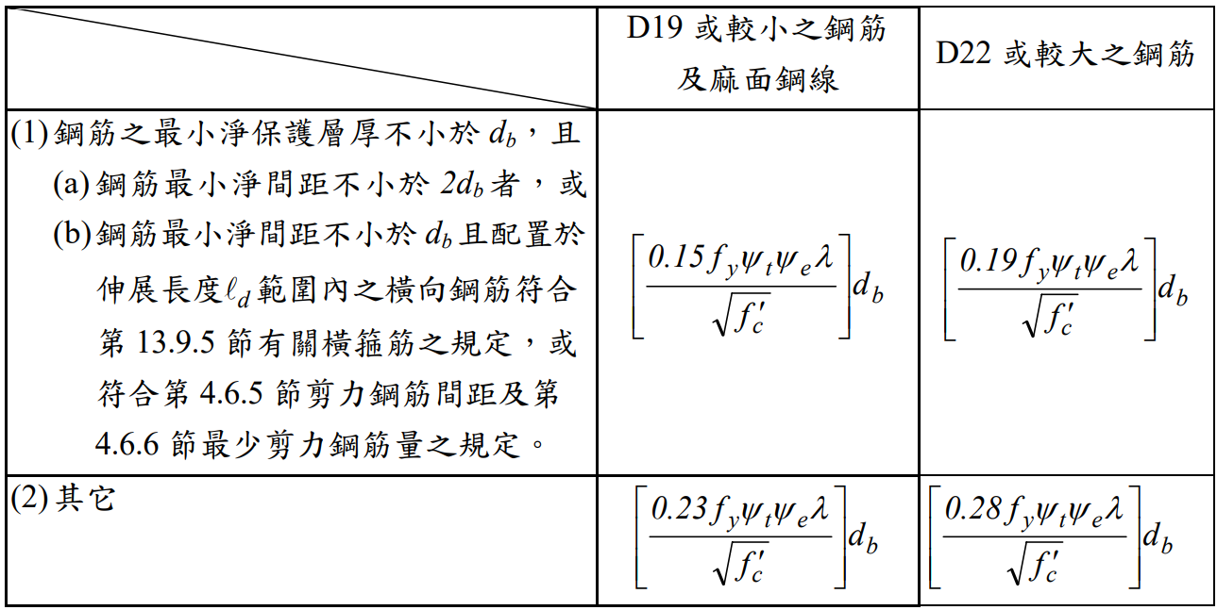
General Development Length Equation
- Demand As
需要更好懂
- After Consider Ld As
MIN
Simplified Provisions
Ld
Notes:
LowSeismic 4Floor 12M 0

Slide 13
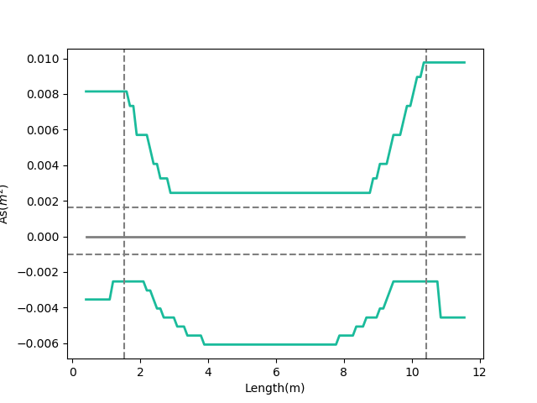
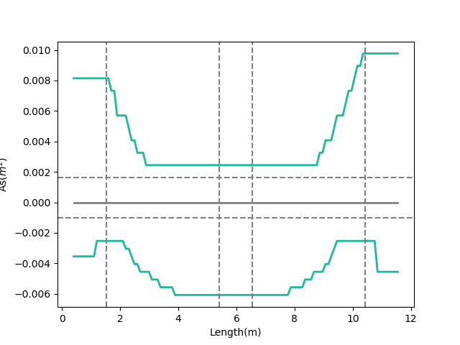

- Consider Ld As
Combinations
多點
0.1
Ln
0.9
Ln
- Consider Ld As
三段
0.1
0.45
0.55
0.9
Notes:
GA 演算法
LowSeismic 4Floor 12M 0

Slide 14
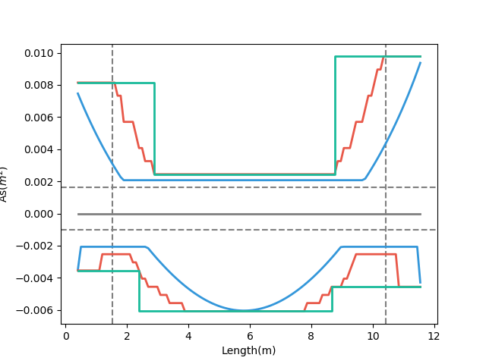
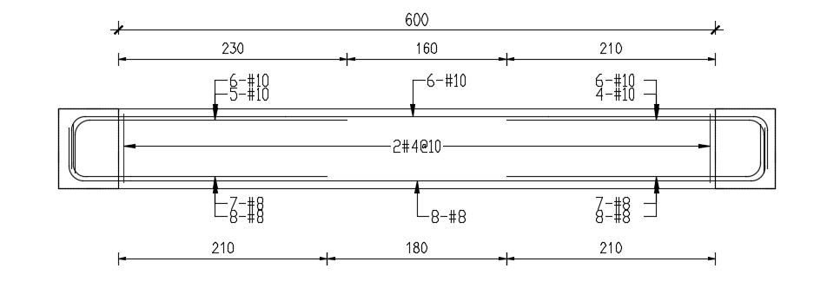
放傳統圖，需要考慮。
兩點斷筋最佳化
Consider Ld As
梁撓曲鋼筋配置示意圖
Design As
Demand As
Notes:
LowSeismic 4Floor 12M 0

Slide 15
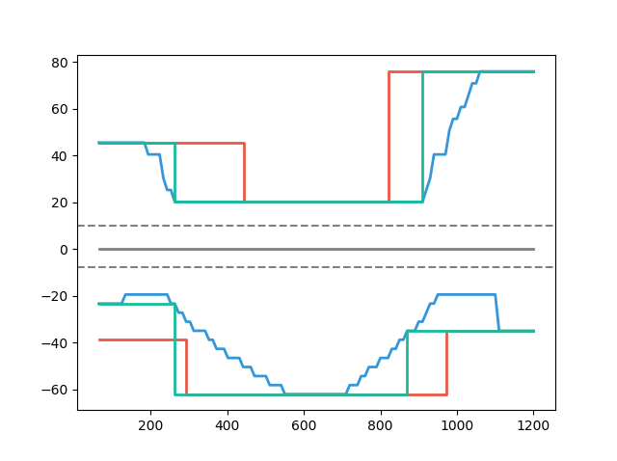
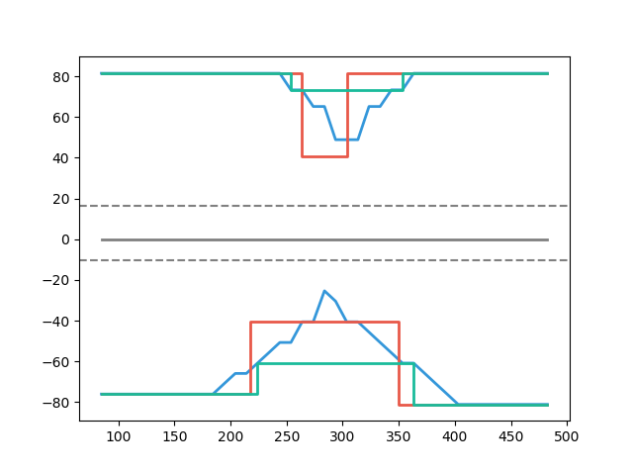
Multi-Cut-2 vs Tradition
- Multi-Cut
- Consider Ld
- Consider Ld
- Tradition
- Tradition
Multi-Cut 82%
As(cm2)
As(cm2)
Multi-Cut 91%
Length(cm)
Length(cm)
Notes:
傳統不經濟
828
傳統不保守 不符合 混凝土結構設計規範 401-100 R5.11.2
1140

Slide 16
Outline
Part 2
Part 4
Flexural Reinforcement Multi-Cut
Seismic Verification
Part 1
Part 3
Objective
Condition

Slide 17
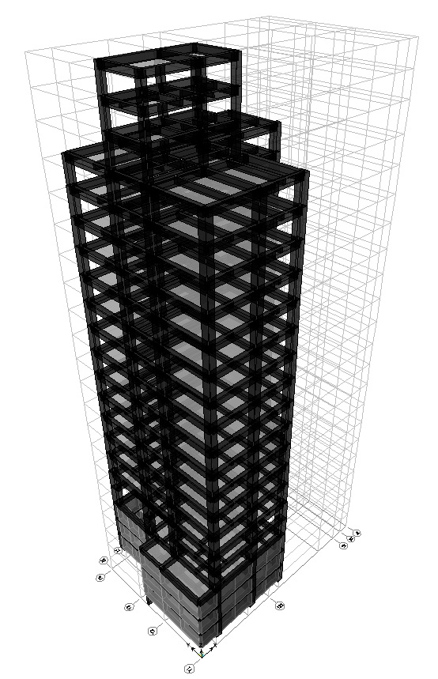
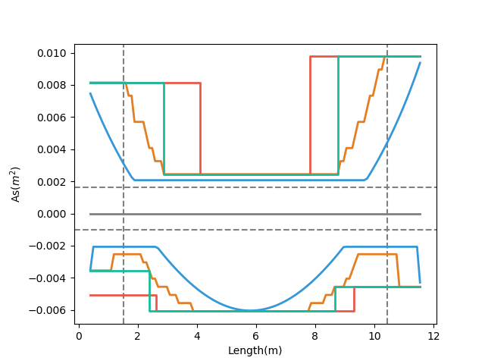
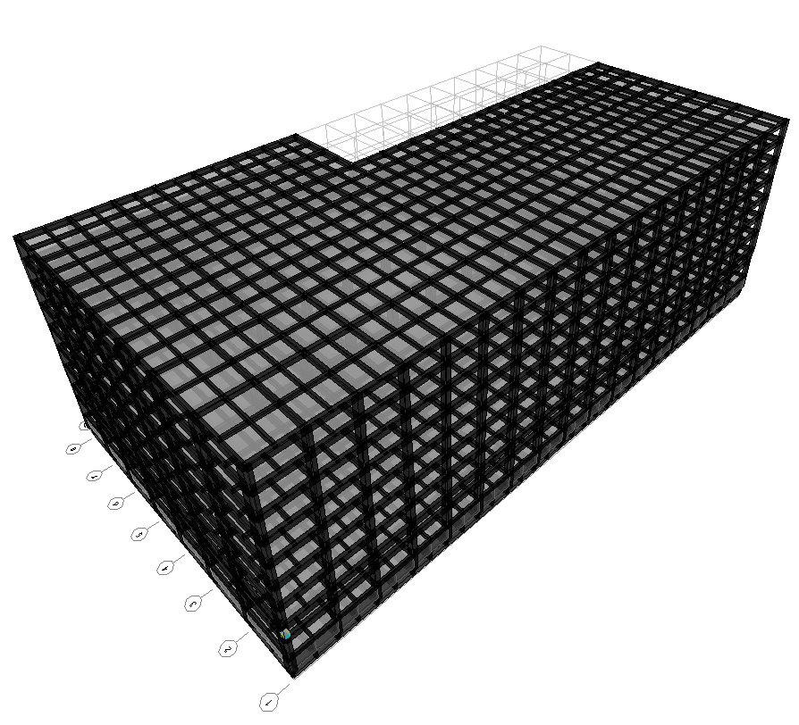
- Tradition As
- Demand As
- Multi-Cut-2
- Consider Ld
台北住宅案
高雄物流中心
Notes:
LowSeismic4Floor12M 0

Slide 18
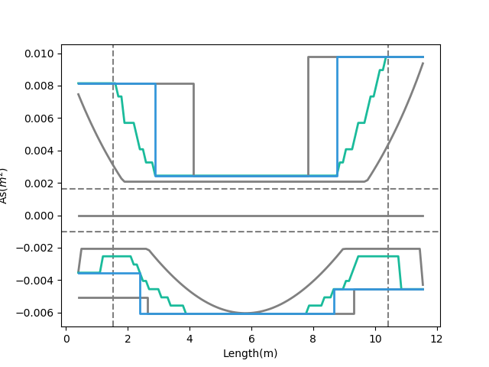
放長的 Ld
- Multi-Cut-2 As
- Consider Ld As
Development Length
Short Development Length
Tradition As
Beam Length
Demand As
Notes:
LowSeismic4Floor12M 0

Slide 19
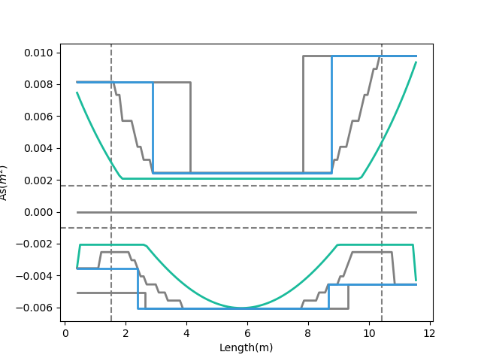
放 Decay small
- Demand As
- Multi-Cut-2 As
Tradition As
Moment Decay
Notes:
LowSeismic4Floor12M 0

Slide 20
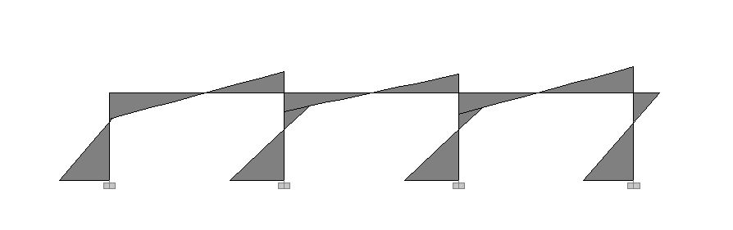
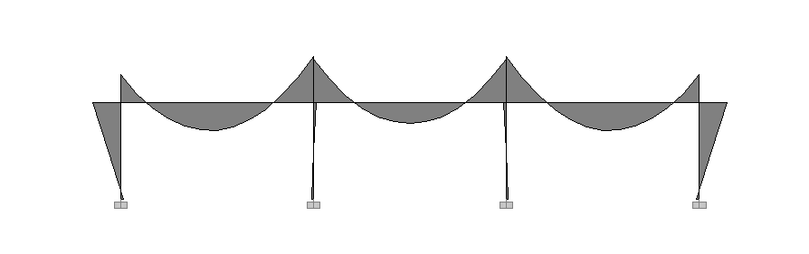
Lateral Load
Lateral
Force
Moment Diagram
Gravity Load
Gravity Load

Slide 21
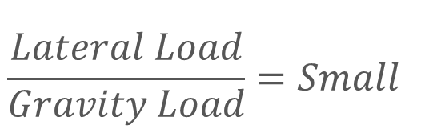
Lateral
Force
Moment Decay
$$\frac{Lateral Load}{Gravity Load}=Small$$
Gravity Load
Beam Length

Slide 22
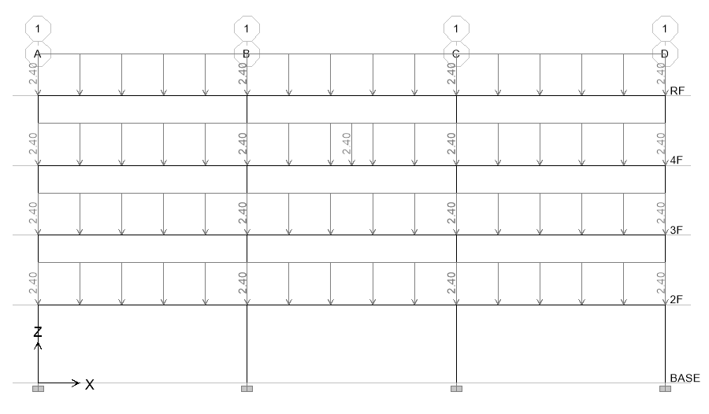
11 Models
Notes:
LowSeismic4Floor12M 0

Slide 23
整體優化結果
放公式
6m
9m
12m
需要更好懂
High Seismic
100.6%
94.2%
94.8%
Middle Seismic
99.6%
95.3%
93.6%
Low Seismic
98.1%
94.5%
90.4%

Slide 24
整體優化結果
6m
9m
12m
High Seismic
100.6%
94.2%
94.8%
Middle Seismic
99.6%
95.3%
93.6%
Low Seismic
98.1%
94.5%
90.4%

Slide 25
上層筋優化結果
6m
9m
12m
High Seismic
103.4%
97.4%
94.9%
Middle Seismic
104.4%
96.0%
91.2%
Low Seismic
99.5%
91.2%
86.0%

Slide 26
下層筋優化結果
6m
9m
12m
High Seismic
96.1%
89.0%
94.6%
Middle Seismic
91.9%
94.3%
97.2%
Low Seismic
96.0%
99.4%
96.5%

Slide 27
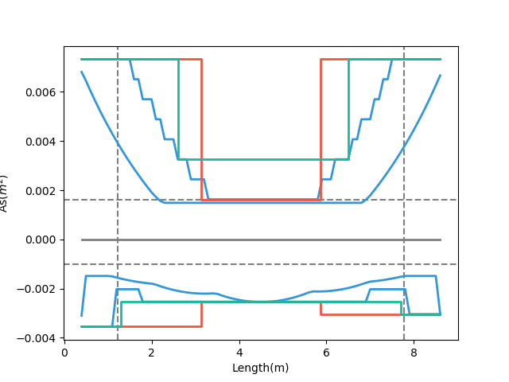
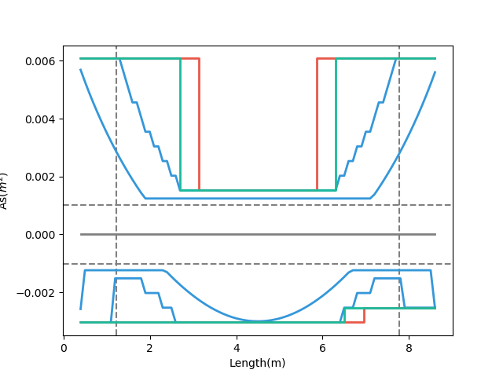
Why?
需要更好懂
High Seismic
Low Seismic
Smaller Gravity 89%
Bigger Gravity 99%

Slide 28
More Multi-Cut
放公式
2
3
4
5
Unlimited
Notes:
理論最佳解

Slide 29
台北住宅案
100.0%
OVERALL RESULT
14F B3
101.3%
TOP RESULT
98.5%
BOT RESULT
20m
30m
Notes:
由於很複雜，先記得最終的結果
400

Slide 30
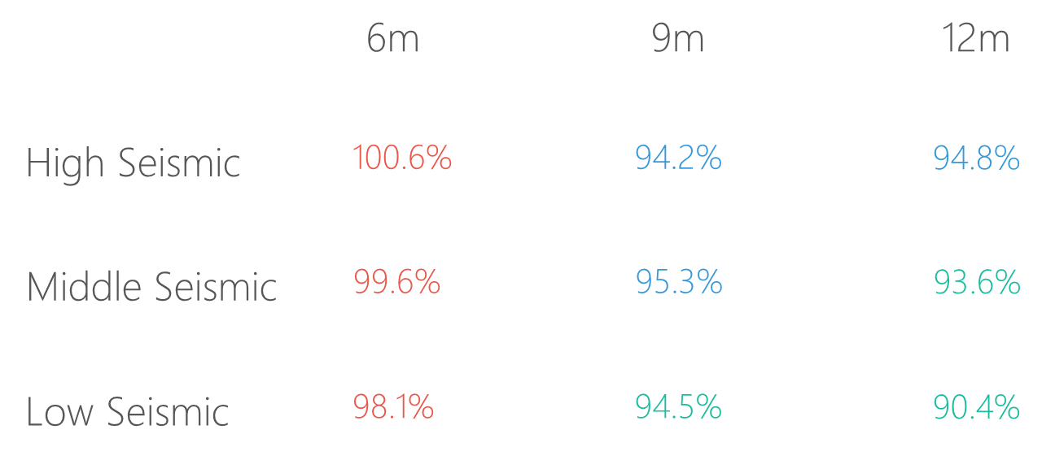
台北住宅案
說明梁長

Slide 31
9F B1
93.4%
OVERALL RESULT
92.3%
TOP RESULT
153m
77m
94.7%
BOT RESULT
高雄物流中心
Notes:
3500

Slide 32
高雄物流中心

Slide 33
Cost Analysis
Reduced Percentage
Material Reduced Cost
$$Δ=−\frac{60kg}{m^{2}}∗2\%∗\frac{\$28}{kg}=−\$33.6/m^{2}$$
Girder Used
Material Cost

Slide 34
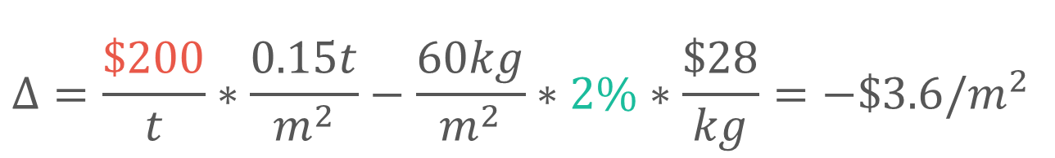
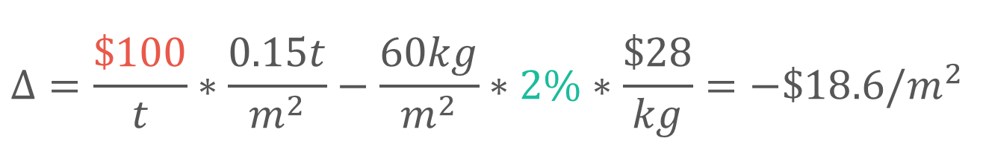
Cost Analysis
大於小於
Increase
Construction Cost
Reduced
Material Cost
$$Δ=\frac{\$100}{t}∗\frac{0.15t}{m^{2}}−\frac{60kg}{m^{2}}∗2\%∗\frac{\$28}{kg}=−\$18.6/m^{2}$$
$$Δ=\frac{\$200}{t}∗\frac{0.15t}{m^{2}}−\frac{60kg}{m^{2}}∗2\%∗\frac{\$28}{kg}=−\$3.6/m^{2}$$
Increase Wage

Slide 35
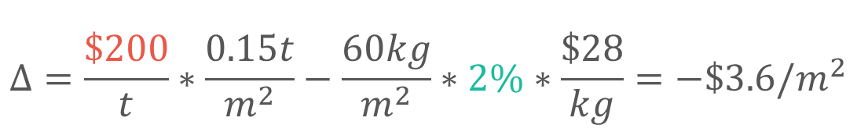
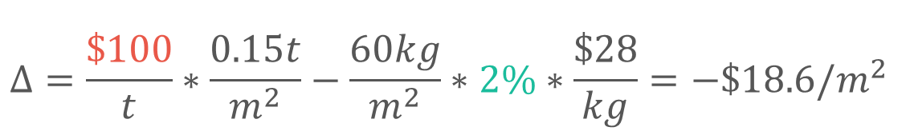
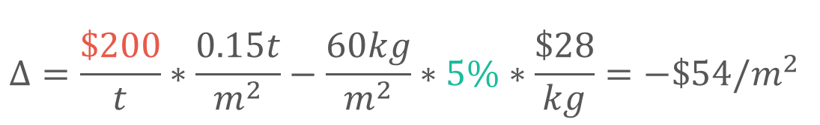
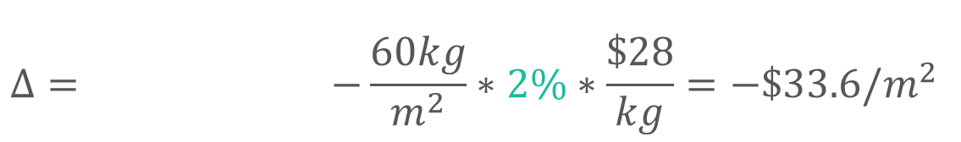
Cost Analysis
$$Δ= −\frac{60kg}{m^{2}}∗2\%∗\frac{\$28}{kg}=−\$33.6/m^{2}$$
$$Δ=\frac{\$100}{t}∗\frac{0.15t}{m^{2}}−\frac{60kg}{m^{2}}∗2\%∗\frac{\$28}{kg}=−\$18.6/m^{2}$$
$$Δ=\frac{\$200}{t}∗\frac{0.15t}{m^{2}}−\frac{60kg}{m^{2}}∗2\%∗\frac{\$28}{kg}=−\$3.6/m^{2}$$
$$Δ=\frac{\$200}{t}∗\frac{0.15t}{m^{2}}−\frac{60kg}{m^{2}}∗5\%∗\frac{\$28}{kg}=−\$54/m^{2}$$

Slide 36
Outline
Part 2
Part 4
Flexural Reinforcement Multi-Cut
Seismic Verification
Part 1
Part 3
Objective
Condition

Slide 37
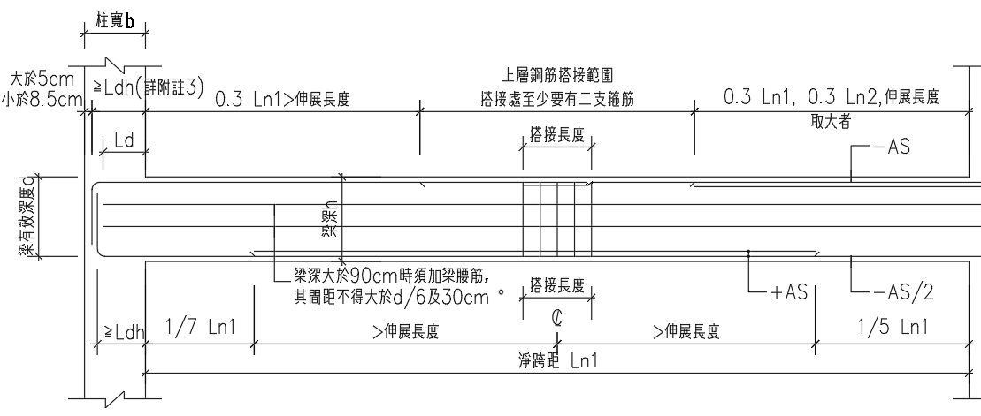
Consider Ld
放圖

Slide 38
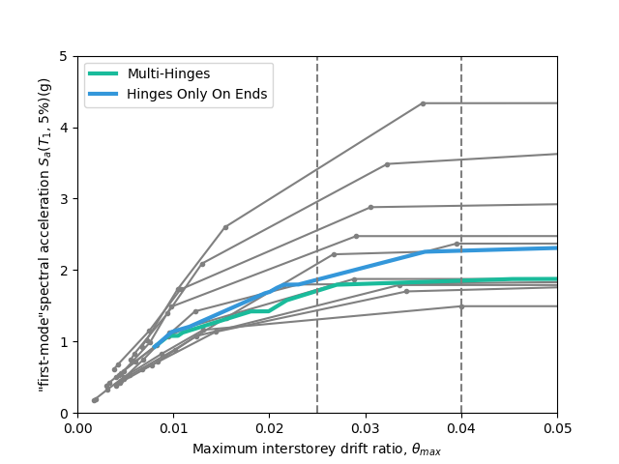
Incremental Dynamic Analysis

Slide 39

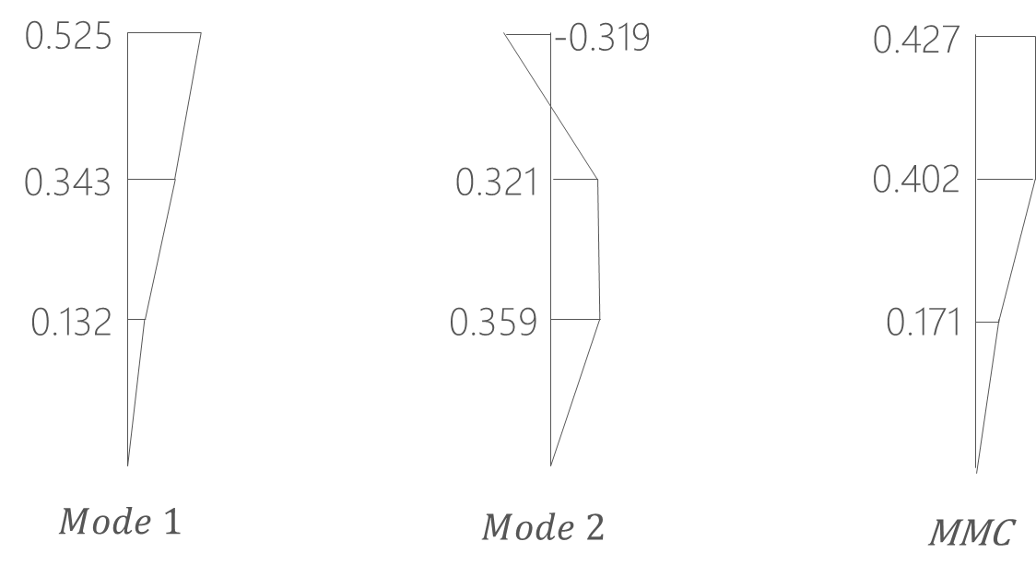
Pushover Load Pattern
Inverted Triangle
Multi-Modes Combination
Modal Pushover Analysis
Mode Shape
Effective Mass
SRSS
Notes:
定義非線性驗證的邊界

Slide 40
Inverted Triangle
Low Seismic 12m 90.4%
Tradition
Multi-Cut-2

Slide 41
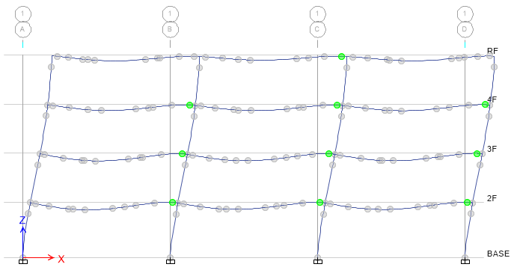
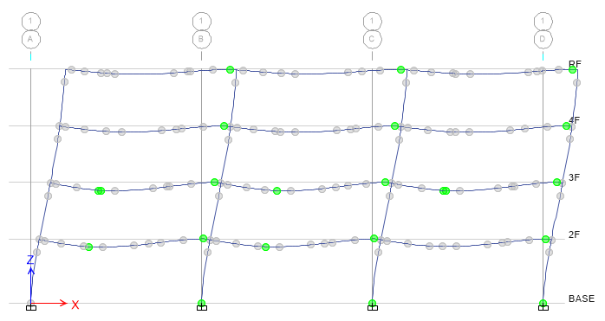
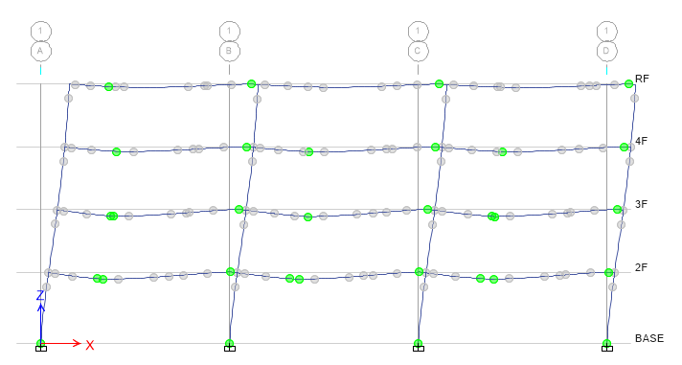
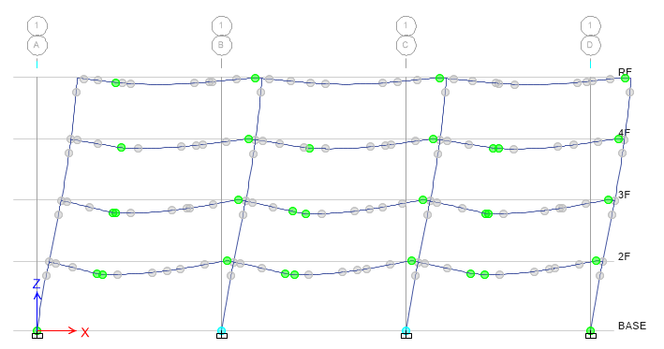
Step 2
Step 3
Step 5
Step 7

Slide 42
Gravity Load
Forth Hinge
+

Slide 43
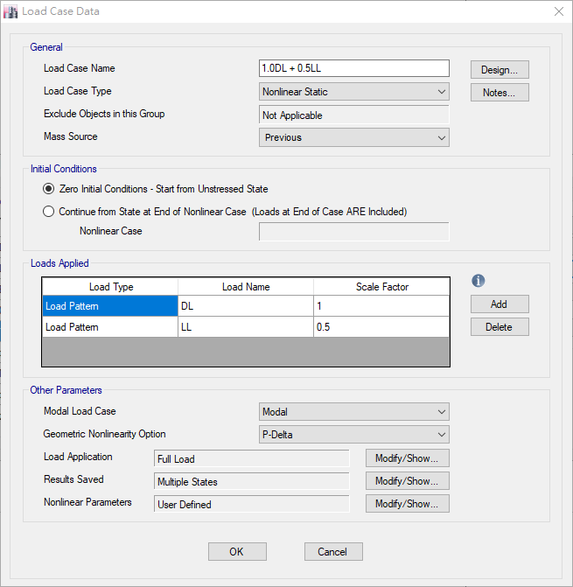
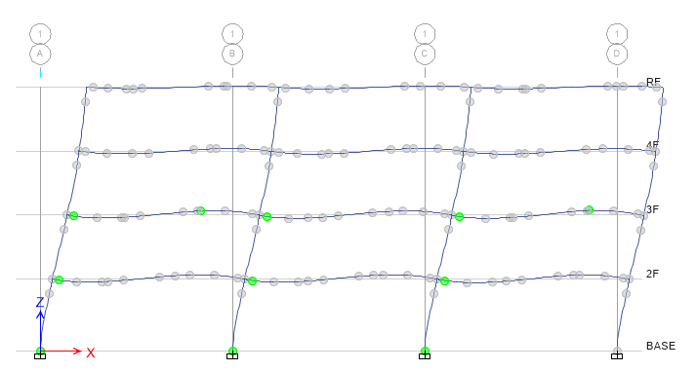
Without Gravity Load
First Hinge
Remove
Previous Case

Slide 44
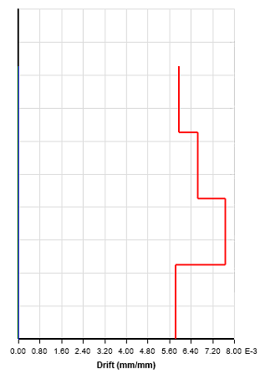
Time history Analysis
放圖例
Story Drift
Scaled to DBE, MCE
DBE < 1.5%
MCE < 2%

Slide 45
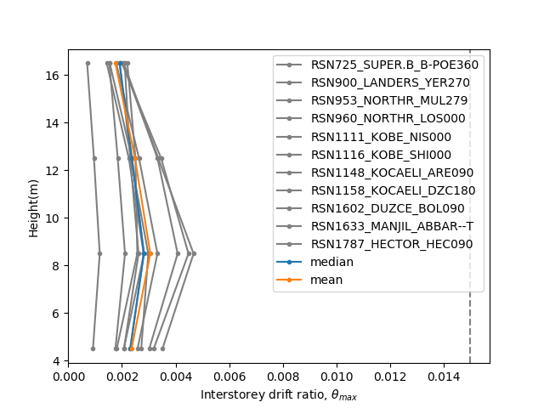

DBE < 1.5%
Low Seismic 12m 90.4%
Tradition
Multi-Cut

Slide 46


MCE < 2.0%
Low Seismic 12m 90.4%
Tradition
Multi-Cut

Slide 47




Tradition DBE
Multi-Cut DBE
Tradition MCE
Multi-Cut MCE
Notes:
DBE 1602 11.5
MCE 1116 15.5

Slide 48


Incremental Dynamic Analysis
Single Static Analysis
➔
Incremental SPO
Single Time History Analysis
➔
Incremental One

Slide 49


Limit-State
4% FEMA273
2.5% SEAOC2000

Slide 50


IDA
Low Seismic 12m 90.4%
換圖標

Slide 51
Conclusion
Condition
Verification
Long Span
Low Seismic
Capacity Close To Tradition
Objective
Construction
Reduce Rebar
Today or Future Cost

